Slide 1
Scars
“Improving Immediate and Long Term Outcomes”
Mark Steven Nestor, M.D., Ph.D.
Director
Center for Cosmetic Enhancement
Center for Clinical and Cosmetic Research
Aventura, Florida
Voluntary Associate Professor
Department of Dermatology and Cutaneous Surgery
Department of Surgery, Division of Plastic Surgery
University of Miami Miller School of Medicine

Slide 2
Disclosures
Activis: Research Grants
Allergan: Research Grants, Advisory Board
Almirall: Consultant, Advisory Board
Bayer Healthcare: Consultant, Advisory Board
Castle: Advisory Board
DUSA Pharmaceuticals: Research Grants
Erchonia: Research Grants
Ferndale: Consultant, Research Grants, Advisory Board
Galderma : Research Grants, Consultant, Advisory Board
IFC: Research Grants
LaLumiere, LLC: Research Grants, Consultant, Advisory Board
LEO Pharma: Advisory Board, Research Grants
Merz: Advisory Board
MELA Sciences: Consultant, Advisory Board
Myoscience: Consultant, Speaker
Neothetics: Research Grants, Research Grant, Advisory Board
Sensus: Consultant
Smith & Nephew : Advisory Board
Strathspey Crown: Shareholder ,Research Grant
Suneva: Advisory Board
Thermiaesthetics: Advisory Board, Speaker
TransDermal: Research Grants, Consultant
Ulthera: Research Grants
Valeant: Research Grants, Consultant, Advisory Board

Slide 3
Scars
Introduction I
Over 100 million patients acquire scars in the industrialized world each year, primarily as a result of elective operations and the global incidence of scarring including burn and other trauma-related wounds easily doubles the incidence.
Scars have the potential to exert a profound psychological and physical impact on the individual. Beyond aesthetic considerations and potential disfigurement, scarring can result in restriction of movement and reduced quality of life.
Brown BC, McKenna SP, Siddhi K, McGrouther DA, Bayat A: The hidden cost of skin scars: quality of life after skin scarring. J Plast Reconstr Aesthet Surg. Sep;61(9):1049-58, 2008.

Slide 4
Scars
Introduction II
Perceived stigma of scars may interfere with communication skills, personal relationships, work life, and leisure activities.
To avoid disfigurement, the majority of adults would go to any lengths to minimize scarring, even if they resulted in only small improvements in scar appearance
The satisfaction of patient with skin cancer correlates significantly with the final aesthetic outcome of surgery
Medical professionals may underestimate the importance of physical appearance for patients with skin cancer
Sobanko et al.. Importance of Physical Appearance in Patients with Skin Cancer. Dermotologic Surgery. Feb 2015

Slide 5
Scars
Introduction III
Scars occur from intention, accident or physiological
  Accidental Scars:
    Trauma
    Burns
  Intentional Scars:
    Surgery
    Laser and other cosmetic procedures
  Physiological
    Striae
May be readily apparent or hidden

Slide 6
Scars
Introduction IV
Scars may heal “normally” or develop into hypertrophic, keloid or atrophic scars
Pain, itching and sensation of constriction are vital considerations at all stages of scar maturity.
Improvement of scar appearance is important at all times in the evolution of a scar whether initially or regarding the final mature scar.
Treatment and camouflage modalities are thereby vital at all stages of scar maturity for both the physical and psychological well being of the patient

Slide 7
Scars
Treatment Options I
Extensive literature on scaring primarily involve treatment or prevention of hypertrophic or keloid scars
Very few studies on optimizing appearance of ‘normal’ scars but patients are very interested in either improving or camouflaging scars during healing and long term
Modalities available to improve clinical aspects and the psychological impact of scars include:
  Cosmetic camouflage techniques
  Pressure, topical preparations and applications
    Pressure alone
    Silicone sheets and Gels
    Onion extract
    Topical Vitamins

Slide 8
Scars
Treatment Options II
  Topical RX
    Imiquimod
    Retinoids
    Mitomycin C
  Injection
    Triamcinolone
    Interferon
    5FU
    Bleomycin
    Verapamil hydrochloride
    Botulinum Toxin

Slide 9
Scars
Treatment Options III
  Surgery, Laser and SRT
    Scar revision (SRT after keloid excision)
    Cryosurgery
    Laser: PDL, fractional
    SRT for Recurrent Keloids
  Experimental Modalities
    Hydrogel Scaffold
    Anti-sense oligonucleotide
    Skin Tension Offloading
    PRP

Slide 10
Selected Literature on Scar Treatment Modalities

Slide 11
Onion extract (OE) gel vs placebo cetearyl alcohol-based lotion (CEA) for scars
Randomized, blinded, placebo control, prospective study of the efficacy and safety of OE gel versus placebo cetearyl alcohol-based lotion (CEA) in 20 subjects with hypertrophic scars and keloids
Subjects were evaluated at baseline & weeks 4, 8, 12,16
Adverse events were noted, photograph taken, and the study scar volume was measured during each visit
The subjects and blinded investigator assessed the scar parameters at each visit with a visual analog scale (VAS) and subjects assessed treatment satisfaction
Perez et al J Drugs Dermatol 9:514, 2010

Slide 12
Mean Percent Improvement of Lesions At Week 16
As Compared to Baseline
70
Placebo -
*
60
*
cetearyl alcohol-
*
based lotion
*
50
Onion extract gel
*
*
(OE)
40
*
Percentage Improvement (%)
30
20
*
*
*
*
10
0
)
)
(
)
Width
)
Volume
Length
(
Induration
Erythema
Pigmentary
Cosmetic
Cosmetic
Alteration
Subject
Investigator
(
*
(
*
)
denotes p<0.05
denotes p<0.05
(
(
)
Perez et al J Drugs Dermatol 9:514, 2010

Slide 13
Onion Extract Gel Effect on the Appearance of New Scars
﻿Randomized, investigator-blind study: bilateral, chest seborrheic keratoses surgically removed in 44 subjects
1 wound was randomly assigned to once daily application of onion extract gel for 8 weeks, and no treatment on the opposite, control wound
At 2, 4 and 8 weeks after gel application, right and left scars were graded by the investigator and subjects for improvement from baseline in overall appearance, texture, redness, and softness using 4-point ordinal scales (0=no improvement, 1=mild improvement; 2= moderate improvement; 3=significant improvement)
Draelos, et al. J Clin Aesthet Dermatol. 2012;5(6):18–24

Slide 14
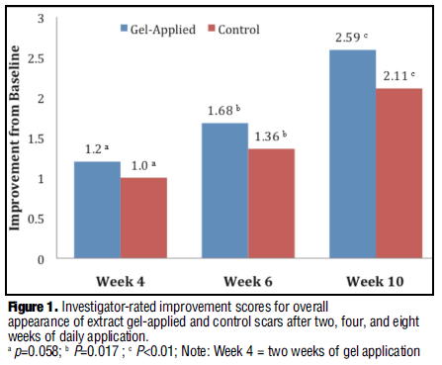
Onion Extract Gel vs Placebo - Scar Improvement in Overall Appearance
Applications 2 Wks 4 Wks 8 Wks
Applications 2 Wks 4 Wks 8 Wks
Investigator-rated
Subject-rated
Draelos, et al. J Clin Aesthet Dermatol. 2012;5(6):18–24

Slide 15
Topical Vitamin E
15 patients who had undergone skin cancer removal given aquaphor and Aquaphor mixed with vitamin E
The scars were randomly divided into parts A and B and subjects used each ointment on half the scar twice daily for 4 weeks in a double blind method. Physicians and subjects independently evaluated which side of the scar looked better if there was any difference on Weeks 1, 4, and 12.
Results: No benefit to the cosmetic outcome of scars by applying vitamin E after skin surgery and that in fact the vitamin E was detrimental to the cosmetic appearance of a scar and 33% developed a contact dermatitis to the vitamin E.
Conclusion: The use of topical vitamin E on surgical wounds should be discouraged.
Baumann LS1, Spencer J: The effects of topical vitamin E on the cosmetic appearance of scars. Dermatol Surg. Apr;25(4):311-5, 1999.

Slide 16
Silicone Gel
Review of literature showed silicone elastomer sheeting is used to prevent the development of and improve the appearance and feel of hypertrophic and keloid scars.
The precise mechanism of action of silicone elastomer sheeting has not been defined.
Clinical trials report that this device is safe and effective for the treatment and prevention of hypertrophic and keloid scars if worn over the scar for 12 to 24 hours per day for at least 2 to 3 months.
Additional controlled clinical trials with large patient populations may provide further evidence for the efficacy of silicone elastomer sheeting in the treatment and prevention of hypertrophic and keloid scars.
Berman B, et al: A Review of the Biologic Effects, Clinical Efficacy, and Safety of Silicone Elastomer Sheeting for Hypertrophic and Keloid Scar Treatment and Management: Dermatol Surg. Nov ;33(11):1291, 2007.

Slide 17
Pulsed Dye Laser
Compare the effect of different pulse durations (450 micros vs. 1.5 ms) in the treatments of postsurgical linear scars.
20 subjects with postoperative linear scars (<2.1 cm) were enrolled prospectively. Scars were randomly divided into three equal sections and the different fields 2 laser and 1 control and received treatment immediately after the sutures were removed and then monthly for 3 months.
The PDL-treated sections demonstrated a statistically significant overall average improvement of the VSS of 92 and 89%, respectively, compared to 67% for the control site.
PDL is safe and effective in improving the quality and cosmetic appearance of surgical scars starting on the day of suture removal with no significant difference between the two pulse durations.
Nouri K, Elsaie ML, Vejjabhinanta V Stevens M, Patel SS, Caperton C, Elgart G: Comparison of the effects of short- and long-pulse durations when using a 585-nm pulsed dye laser in the treatment of new surgical scars: Lasers Med Sci. Jan;25(1):121-6, 2010

Slide 18
International Recommendations
OBJECTIVE: To update the management algorithm for pathologic scarring to reflect best practice standards at present.
MATERIALS AND METHODS: Management recommendations were derived from a comprehensive literature search and clinical experience and consensus opinion of advisory panel members.
RESULTS: A combination approach using multiple modalities provides the maximum potential for successful treatment of hypertrophic scars and keloids. The advisory panel advocates a move toward more aggressive initial management of keloids, including earlier application of 5-fluorouracil. A growing body of clinical research supports a place in therapy for newer agents (e.g., bleomycin, onion extract, imiquimod, mitomycin C) and laser therapy (pulsed-dye, fractional) for scar management.
CONCLUSION: Prevention and treatment of pathologic scarring requires individualized care built upon the principles of evidence-based medicine and continues to evolve in step with technological and scientific advances.
Gold MH, McGuire M, Mustoe TA, Pusic, A, Sachdev M, Waibel J, Murcia C: Updated International Clinical Recommendations on Scar Management: Part 2—Algorithms for Scar Prevention and Treatment:: Dermatologic Surgery: August 40(8), 825–831, 2014.

Slide 19
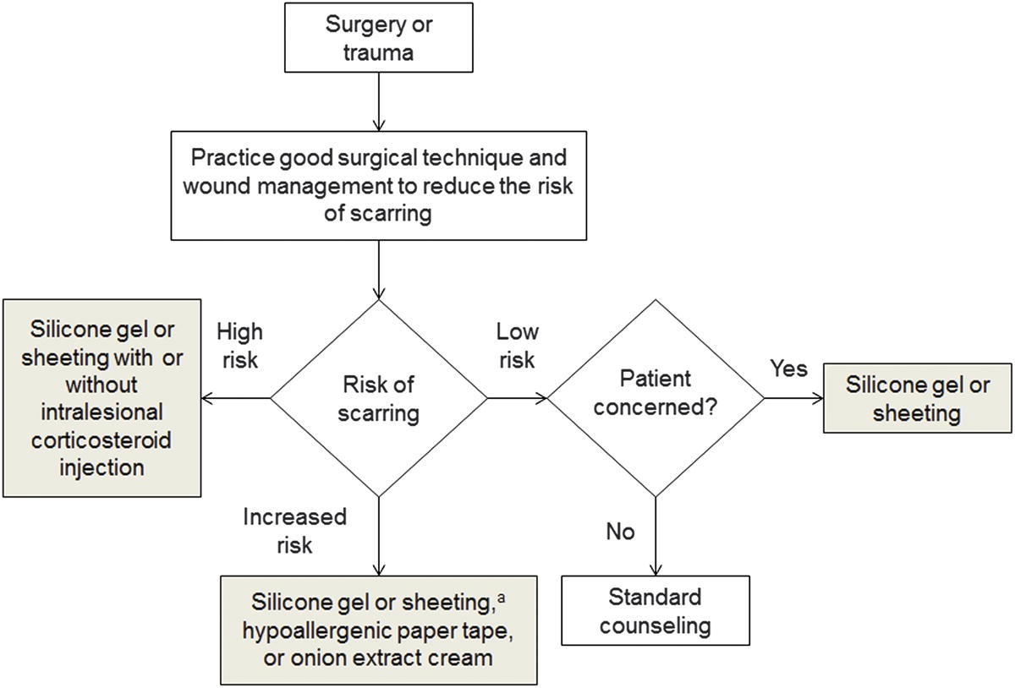
International Recommendations
Gold MH, McGuire M, Mustoe TA, Pusic, A, Sachdev M, Waibel J, Murcia C: Updated International Clinical Recommendations on Scar Management: Part 2—Algorithms for Scar Prevention and Treatment:: Dermatologic Surgery: August 40(8), 825–831, 2014.

Slide 20
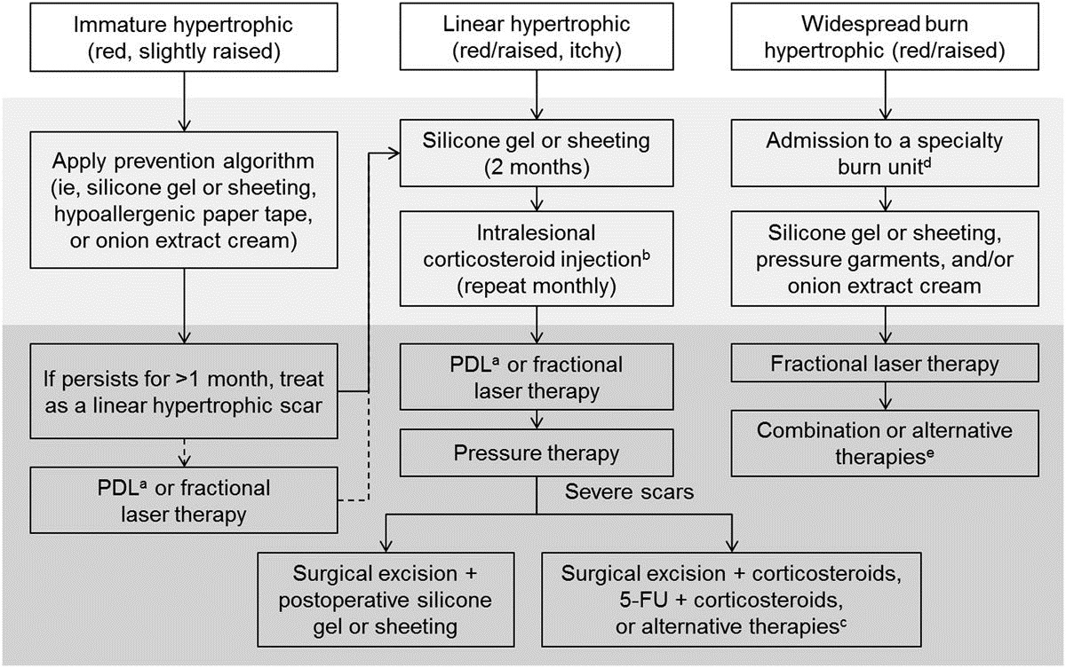
International Recommendations
Gold MH, McGuire M, Mustoe TA, Pusic, A, Sachdev M, Waibel J, Murcia C: Updated International Clinical Recommendations on Scar Management: Part 2—Algorithms for Scar Prevention and Treatment:: Dermatologic Surgery: August 40(8), 825–831, 2014.

Slide 21
Silicone Based Camouflage (Dermaflage)
Combines immediate camouflage with benefits of topical silicone gel
Custom topical filler
  Matches tone, texture and topography of defect
Medical grade, platinum silicone
  Improves appearance during scar remodeling period
Daily application by consumer
  Bonds with skin from 12-36 hours (optimal time)

Slide 22
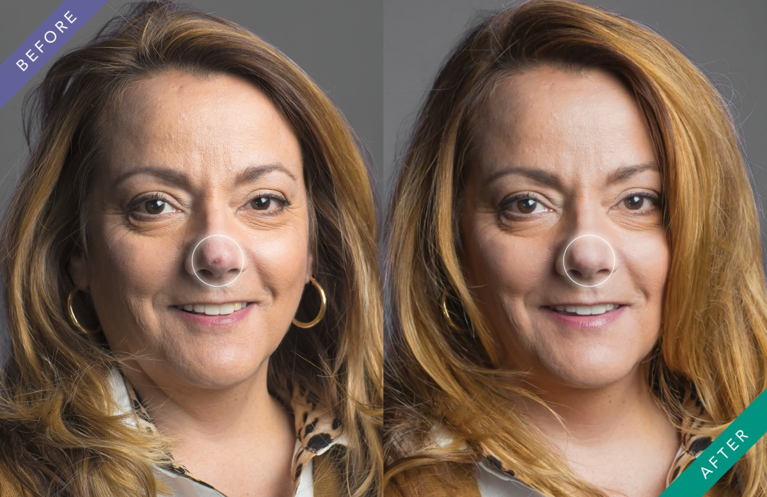
Basal Cell Carcinoma

Slide 23
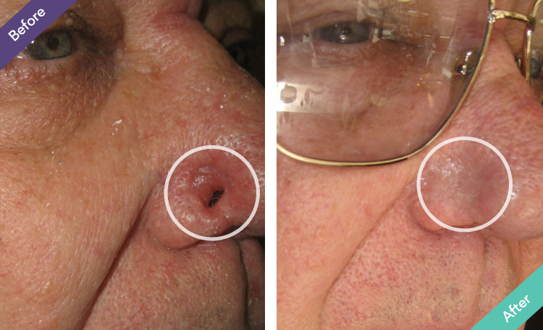
Basal Cell Carcinoma

Slide 24
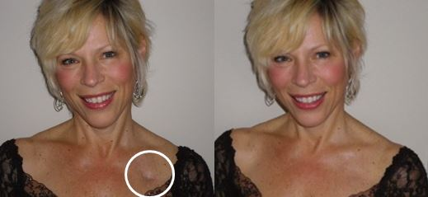
Catheter site

Slide 25
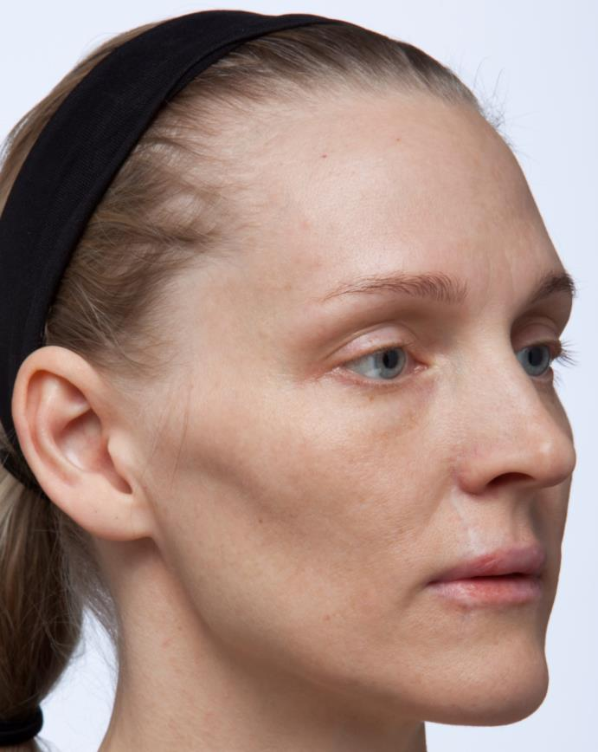
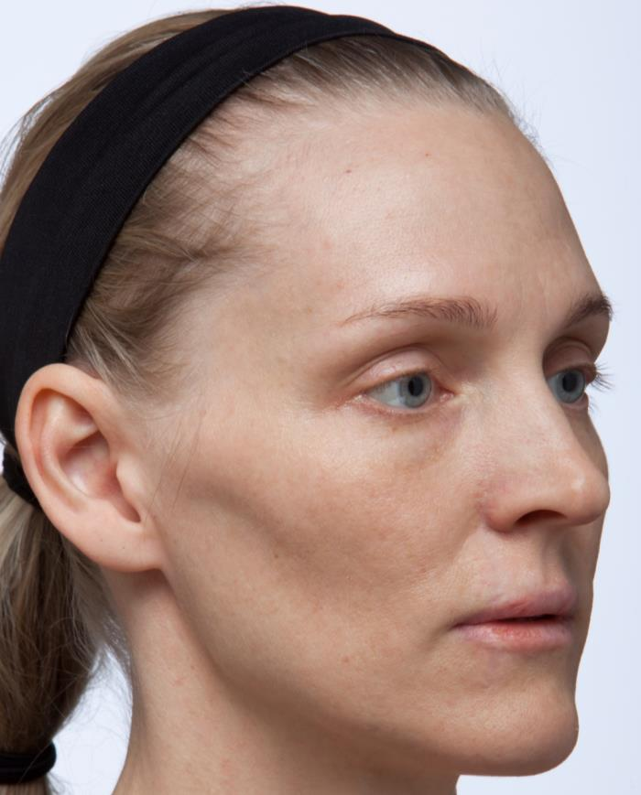
Trauma

Slide 26
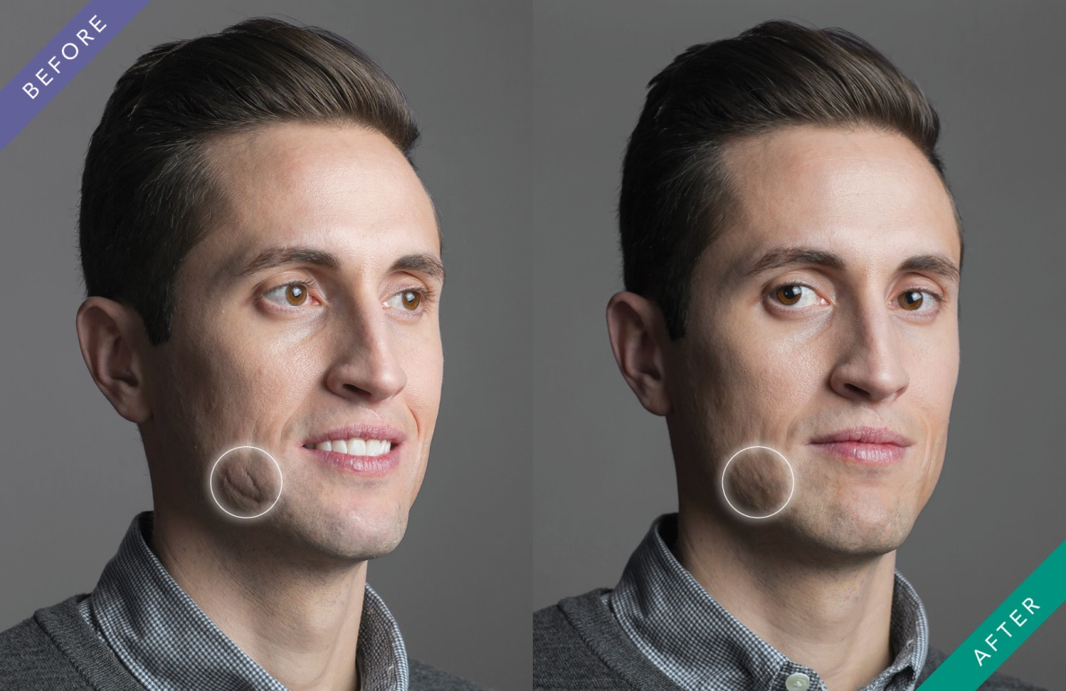
Trauma

Slide 27
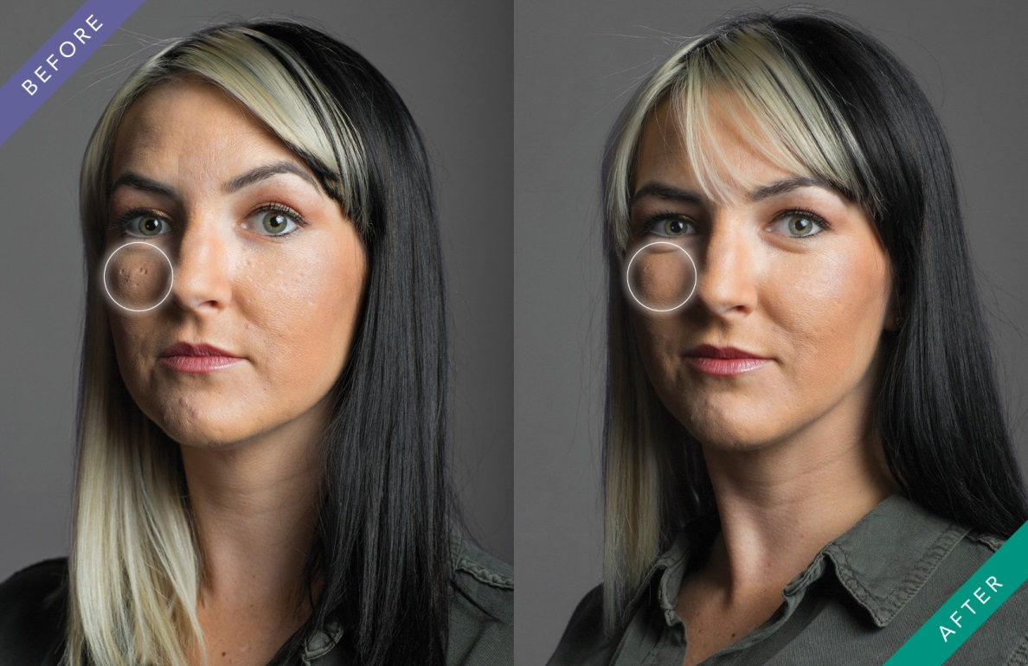
Acne Scar

Slide 28
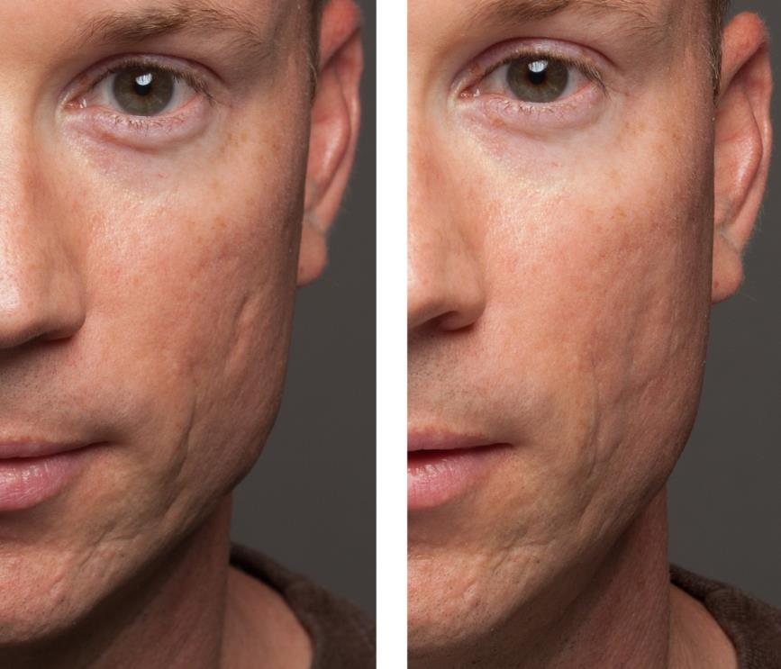
Acne Scar

Slide 29
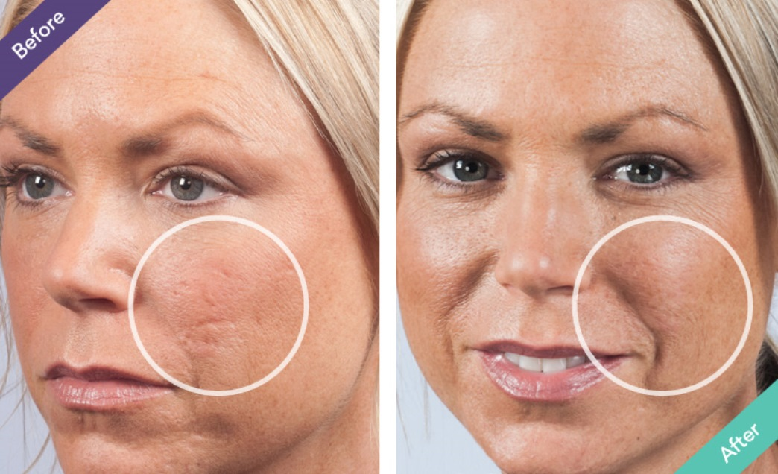
Acne Scar

Slide 30
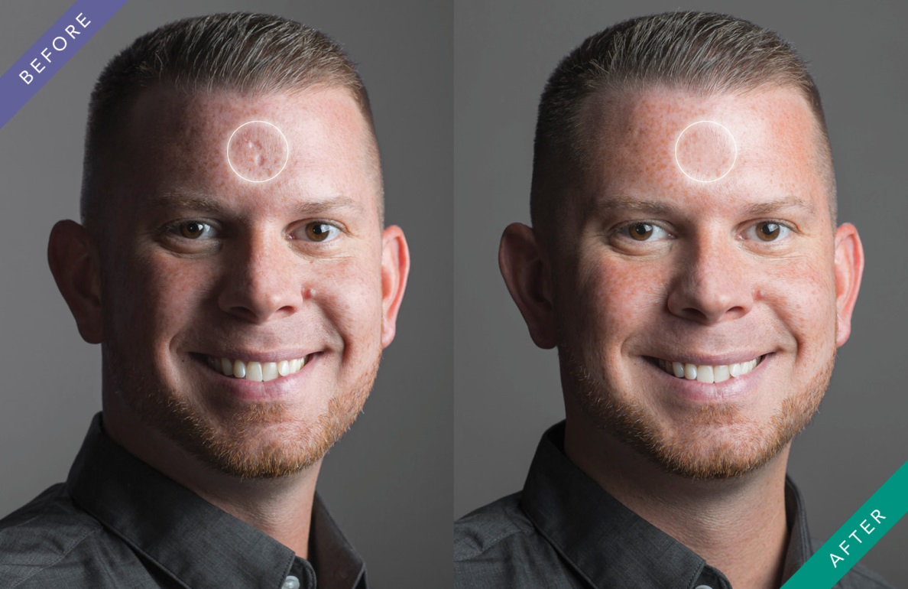
Chicken Pox Scar

Slide 31
Scars
Summary and Conclusions
Scars occur from intention, accident or physiological
Perceived stigma of scars may interfere with communication skills, personal relationships, work life, and leisure activities.
Treatment and camouflage modalities are vital to the physical and psychological well being of the patient
Majority of the literature in on treatment or prevention of keloids, multiple treatment options are effective and silicone gel is the most widely used
Combination of immediate camouflage with benefits of topical silicone gel may be ideal but more research is needed

